Slide 1
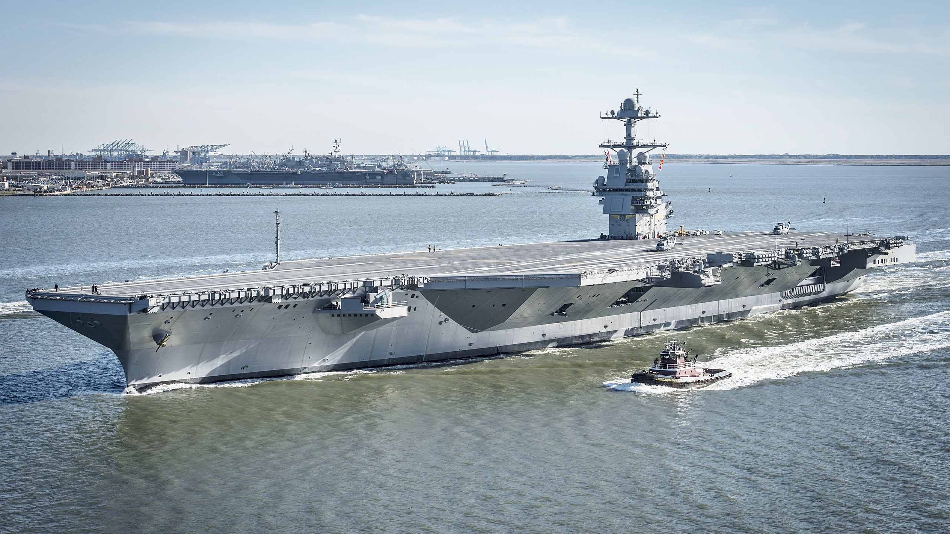
AIRCRAFT CARRIERS
Kendall Carter
Nov 2017
NI SE Australia Branch
Notes:
LADIES AND GENTLEMEN, GOOD EVENING,
It’s a pleasure to be here tonight to talk to you about Aircraft Carriers. Of course a lot of vessels carry aircraft, from tuna fishing boats and pleasure yachts with their own helicopters, right through to what we see here in this slide, a picture of the USN’s latest aircraft carrier, the USS Gerald R Ford taken earlier this year in Hampton Roads Virginia.
I am going to concentrate on the fixed wing aircraft carrier, leaving aside the current crop of helicopter only ships that are operating.
But first let me introduce myself for those of you who don’t know me too well.
I joined the RN straight out of school in 1973, as a university cadet entry officer – going to Southampton University in Southern England to study Chemistry during term time, and heading to sea in the university vacations, and after graduation attending Britannia Royal Naval College in Dartmouth where I passed out in 1977 as a Sub Lieutenant. I only intended to stay for 5 years then get a proper job, but in this as in so many other aspects of my life I was wrong, and ended up remaining in the RN for 34 years – retiring when my contract expired at the age of 53 in Dec 2007. I then emigrated here with my lovely Australian wife Gilli and lived happily ever after.
During my time in the Royal Navy I served in most types of surface naval ships, from patrol boats through frigates destroyers and in, the focus of this presentation, Aircraft Carriers.

Slide 2
HMS ARK ROYAL
Notes:
I served in HMS Ark Royal from June 1990 to November 1992. At the time she was one of the Royal Navy’s 3 fixed wing carriers, the other two being HMS Invincible, and HMS Illustrious operating an air wing consisting of Sea Harrier short take off and vertical landing fighters, and Sea King helicopters. I was the Navigator. This position is not exactly like the 2nd officer’s position in a merchant vessel. The Commanding Officer of a carrier is often an aviator, and the navigator is his ship handling, navigation and manoeuvring consultant if you like. There were only a handful of officers qualified for the job, and it was difficult to get that qualification – involving sea time in other vessels, and the completion of a year long principal warfare officer’s course and then a year long specialist navigation course, and finally passing the Advanced Navigation Sea Check to become eligible. The navigator is a deep specialist ship handling and navigation officer able to manoeuvre, and if no pilots are available, berth and unberth the ship. He lived at the back of the bridge whilst at sea, one of only three officers with cabins on the island, the other two being the Captain and the Air Commander.

Slide 3
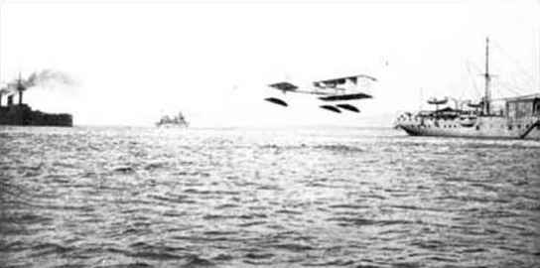
HISTORY
KITES
BALLOONS
SEAPLANES
Notes:
The history of the fixed wing aircraft carrier started before there were fixed wing aeroplanes. Firstly with kites flown from ships in the early 1800s in this case to carry propaganda leaflets, releasing the kites to land in enemy territory. Then balloon ships in the first world war for observation and about the same time seaplanes were being tried out from ships. This is a picture of the French Ship Foudre the first seaplane carrier, with a seaplane in 1910. In the same year the US navy and the Royal Navy were trying out this new technology.

Slide 4
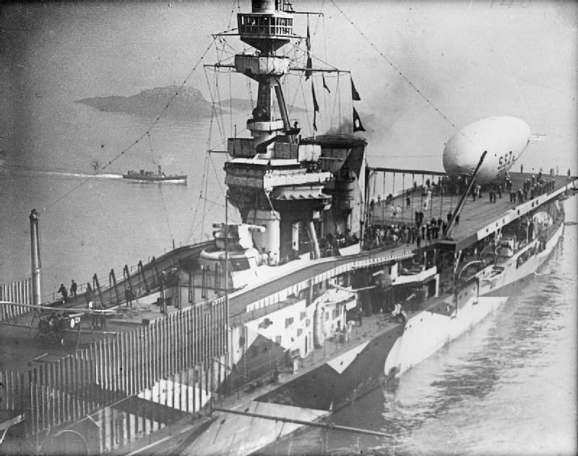
HISTORY
HMS ARK ROYAL 1914
FIRST LANDING 1917
Notes:
A PREVIOUS INCARNATION OF HMS Ark Royal launched in 1914 was arguably the first purpose built aircraft carrier, and in 1917 Squadron Commander EH Dunning performed the first ever landing on a carrier landing his Sopwith Pup on HMS Furious (pictured here) in Scapa Flow in the Orkney Islands to the North of Scotland.

Slide 5
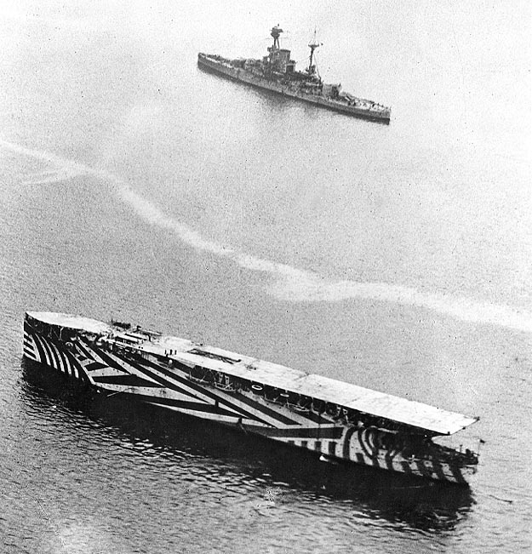
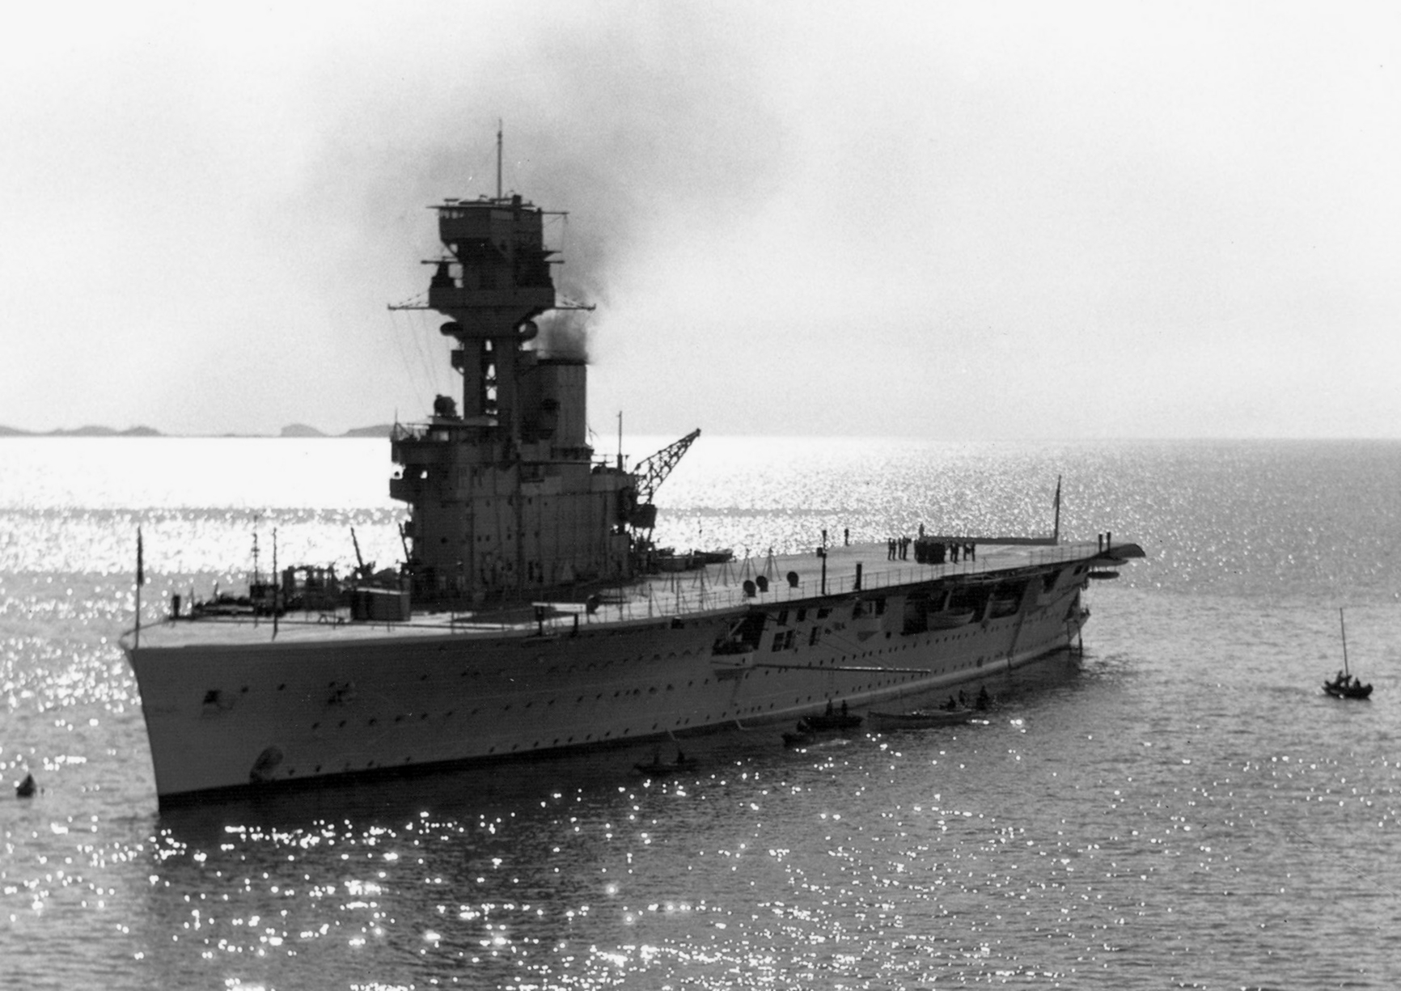
HISTORY
HMS ARGUS 1918
HMS HERMES 1924
Notes:
The first ship with a full length flat deck was HMS Argus built in September 1918, but the first purpose built aircraft carrier with a starboard side control island and full length flight deck was HMS Hermes in 1924. This configuration is still used today.
Production, development and use of aircraft carriers then massively expanded throughout the world. Japan, the United States and the UK all used aircraft carriers in the second world war. The age of the battleship was over.

Slide 6
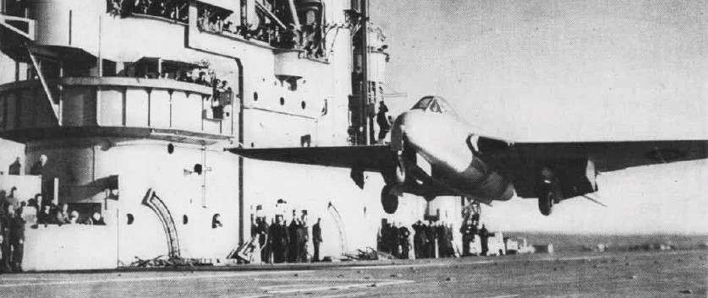
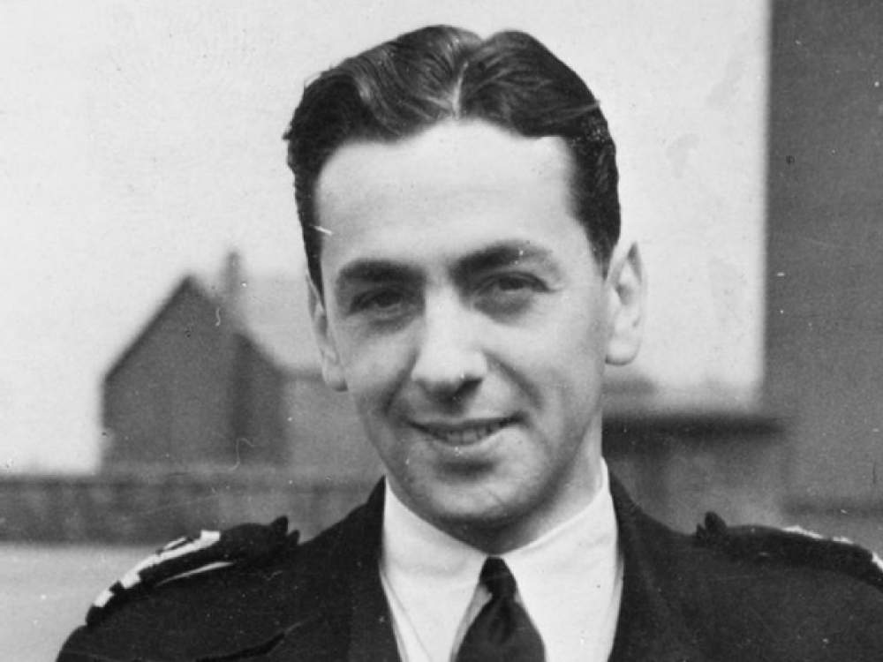
HISTORY
Notes:
After the war the jet age was born. The first landing by a jet on an aircraft carrier was performed by Lt Cdr Eric “Winkle “ Brown in a De Haviland Vampire in December 1945 on HMS Ocean. Nicknamed Periwinkle because of his diminutive height, Brown was a remarkable man. He holds the record for the most aircraft carrier take offs and landings (2407 and 2271 respectively) and flew in 487 different types of aircraft in his long and illustrious career, more than anyone else in history. He sadly passed away in February2016 aged 97.

Slide 7
THE ANGLED FLIGHT DECK
Notes:
Landing on an aircraft carrier was initially a primitive affair, with aircraft being simply caught by a number of deck hands who would run out to grab the aircraft to slow it down, with nets as a backstop if this failed. Later arresting wires and tailhooks were invented but it was still a dangerous process.
The generation of jets planned for the 1950s were much heavier than their predecessors, had higher landing speeds and would have needed most of the deck available to complete an arrested landing. The standard technique of centreline landings with a barrier to protect the deck park forward from aircraft that missed the wires was no longer tenable and, with little or no room for the deck park, the number of aircraft that could be operated was small.
Worse still; if the whole deck had to be clear for every landing, the number of aircraft operated at any one time would be low and the speed with which they could be recovered would be slow. The angled deck, invented by Captain Dennis Campbell Royal navy, solved this dilemma by providing a landing runway that was longer than the portion of deck aft of the existing barriers.
Not only did the angled deck provide a longer runway in which the arrester wires could be moved nearer the centre of pitch to make landing easier in bad weather but other advantages soon became apparent. There was no longer a need for a barrier since, with clear deck space ahead of the wires, an aircraft that missed the wires, known as a 'bolter', could open the throttle to go round for another circuit. The area to starboard of the runway gave clear parking space for a number of aircraft, allowing rapid multiple aircraft recoveries and a deck park for refuelling and re-arming and launching. It was soon adopted worldwide in the 1950s, by the US Navy in their Forrestal Class, The UK in the latest incarnation of HMS Ark Royal and was used in HMAS Melbourne.
The steam catapult was invented about the same time Jet Carrier operations were now much more efficient.

Slide 8
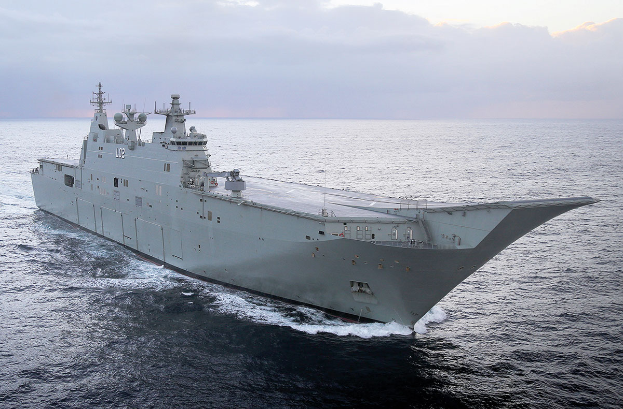
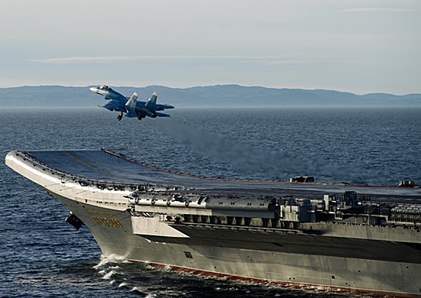
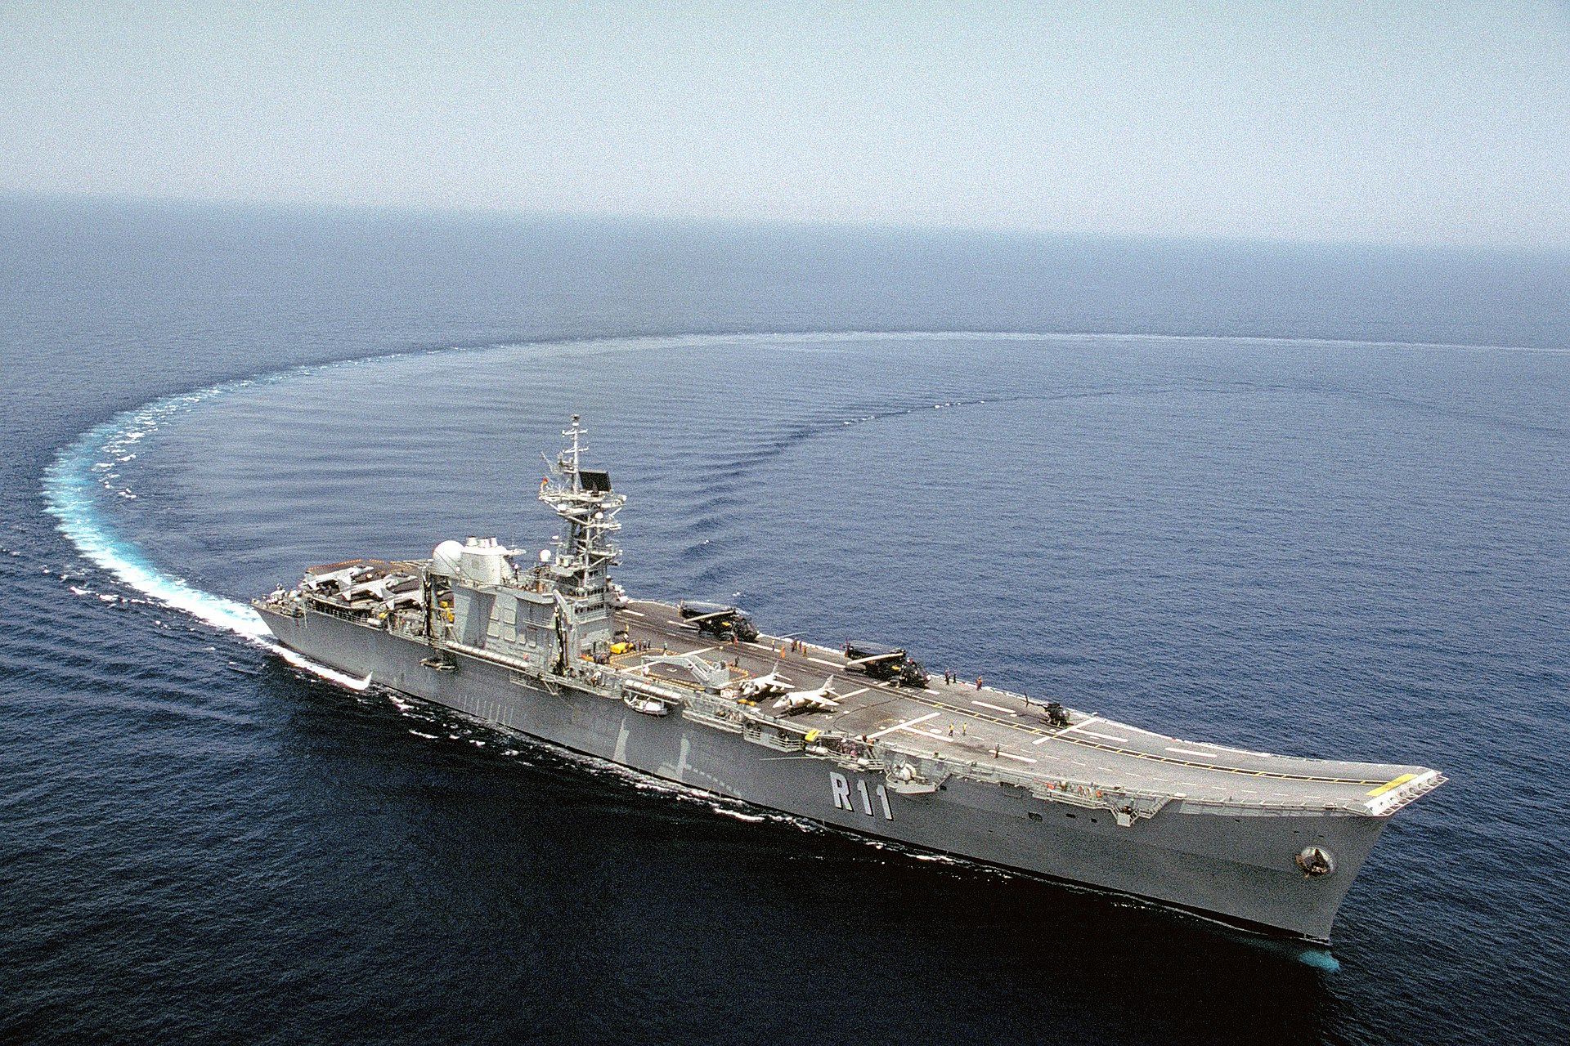
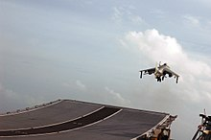
THE SKI JUMP
Russian Carrier Admiral Kuznetsov
HMAS Canberra
Indian Naval Ship Vikrant
HMS Invincible
Spanish Carrier Principe De Asturias
Notes:
In 1973, Lt Cdr D.R. Taylor of Britain's Royal Navy proposed the ski-jump for use with the Harrier Jump Jet.
The principle is, fixed-wing aircraft must build up forward speed during a lengthy takeoff roll. As the forward velocity increases, the wings produce greater amounts of lift. At a high enough speed, the lift force will exceed the weight of the aircraft, and the aircraft will become capable of sustained flight. On an aircraft carrier, the flight deck is so short that most aircraft cannot reach flight speed before reaching the end of the deck. A ski-jump ramp at the end of the flight deck redirects the aircraft to a slight upward angle, converting part of the aircraft's forward motion into a positive rate of climb. the ski-jump launch gives the aircraft additional time to continue accelerating.^{[3]} By the time its upward velocity has decayed to zero, the aircraft will be going fast enough for its wings to produce enough lift. ^{2]}Many modern aircraft carriers lack catapults, so heavy aircraft must take off using their own engines. Ski-jumps make it possible for heavier aircraft to take off than a horizontal deck allows. However, ski-jump launches cannot match the payloads made possible by high-speed catapult launches. With short take off and vertical landing aircraft, such as the Harrier or a version of the new F 35 Joint Strike Fighter, some vectored thrust is also used in take off. Note HMAS Canberra has a ski jump – but there are currently no plans for fixed wing operations. A classic case of fitted for but not with.

Slide 9
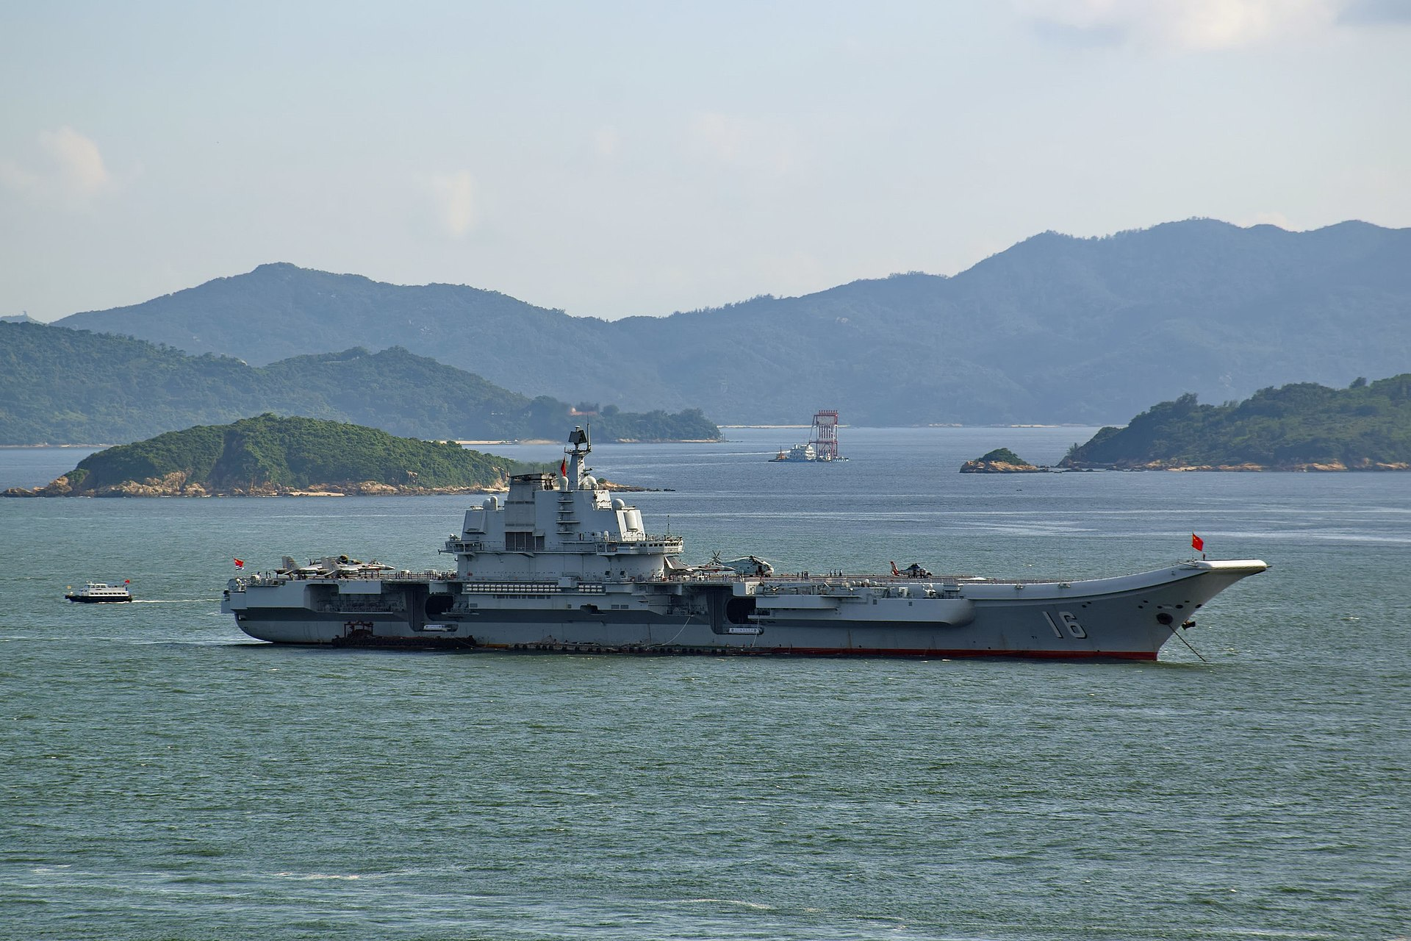
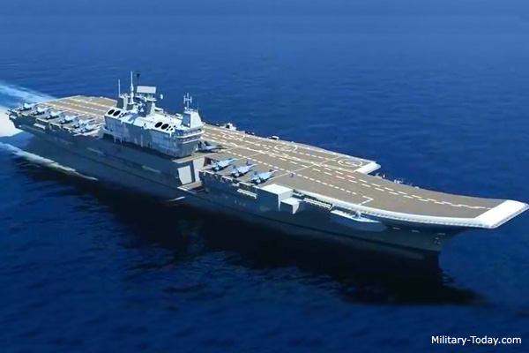
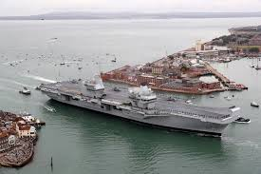
PROPULSION & MANOEVERING 1
CONVENTIONAL
Steam Turbine Chinese Naval Ship Liaoning
Gas Turbine INS Vikrant
Gas Turbine - Diesel – Electric
HMS Queen Elizabeth
Notes:
Aircraft Carriers can be powered in several different ways. The non nuclear option – taken by most operators in the world apart from the United States and France can be broken down into 3 main types. The classic boiler and steam turbine approach, used for many years – continuing in use today by for example the Chinese Navy, or the last Australian carrier HMAS Melbourne; the full gas turbine approach, used in the Indian Navy Ship Vikrant and the old Invincible class carriers – like Ark Royal, or the new propulsion system where gas turbines run diesel generators to power the ship, as in the new Queen Elizabeth class in the UK or HMAS Canberra – which is not a fixed wing carrier but is Commanded by one of our Nautical Institute branch members Ashley Papp – so I need to keep mentioning it.

Slide 10
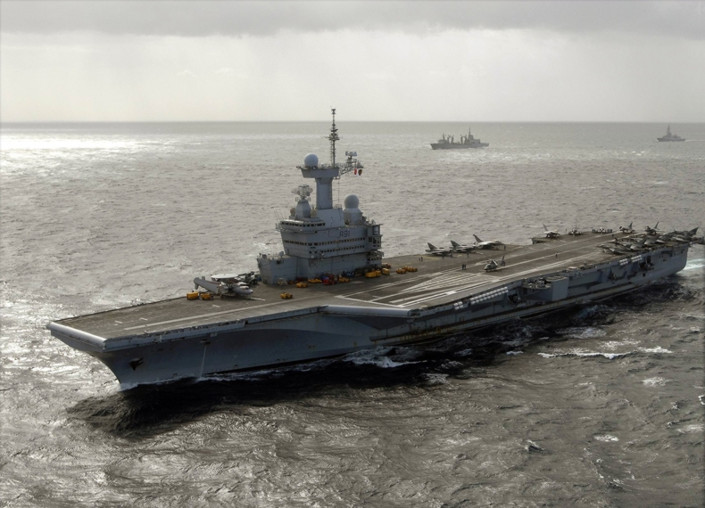
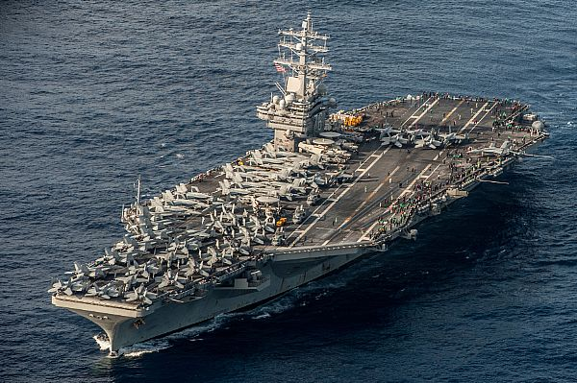
PROPULSION & MANOEVERING 2
Nuclear
French Ship Charles De Gaulle
USS Ronald Reagan
Notes:
Only 2 nations operate nuclear powered aircraft carriers – The United States and France. They are essentially steam powered with the nuclear reactors providing power for the boilers. They have unlimited range, but of course still need to refuel to operate aircraft. They are very expensive to build. The USN currently has 11 of them, France just the one.

Slide 11
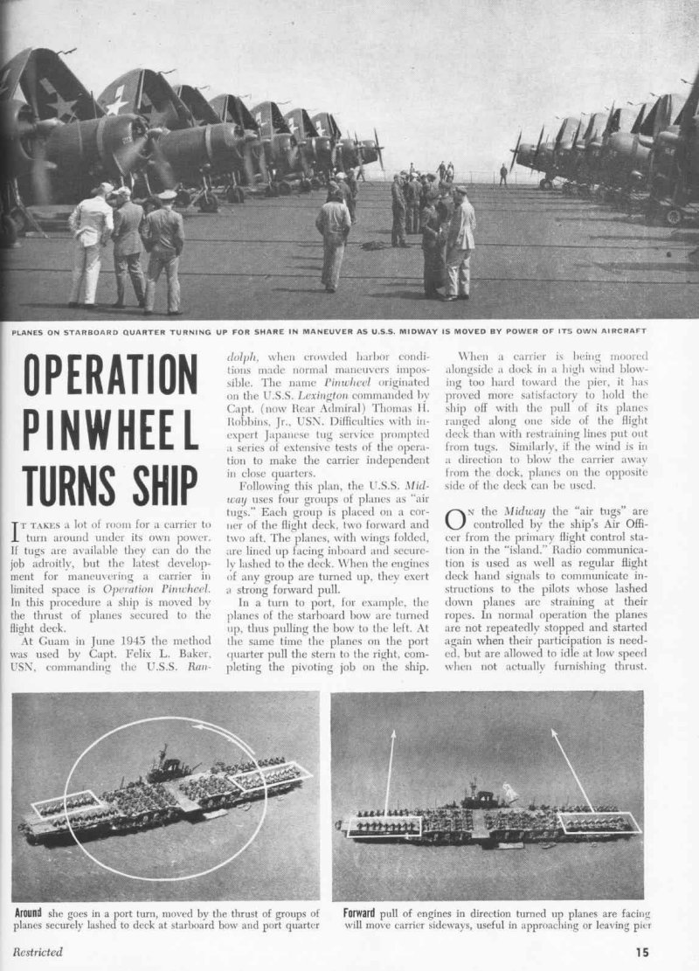
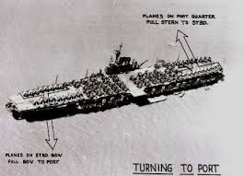
PROPULSION & MANOEVERING 3
PROPELLERS AND PROPULSORS
Notes:
Aircraft Carriers come with a variety of power transfer systems - they can either have a single shaft and propeller like the Spanish Principe De Asturias, 2 props like the Ark Royal or the new Queen Elizabeth, 4 props like the big USN Carriers or pod propulsors like HMAS Canberra – which is not a fixed wing carrier as I may have mentioned – but we like to keep it local!
Aircraft carriers do not have bow or stern thrustors. They need tugs to berth and unberth – or maybe not.
In 1945 USS Midway got into a Japanese Port using its planes lashed to the deck as thrusters. It was called operation pinwheel. When I joined Ark Royal there was a page devoted to it in the ship’s Navigation Data book using Sea Harriers as thrusters. It might have been a bit noisy. I do not think anyone in modern times has used it.

Slide 12
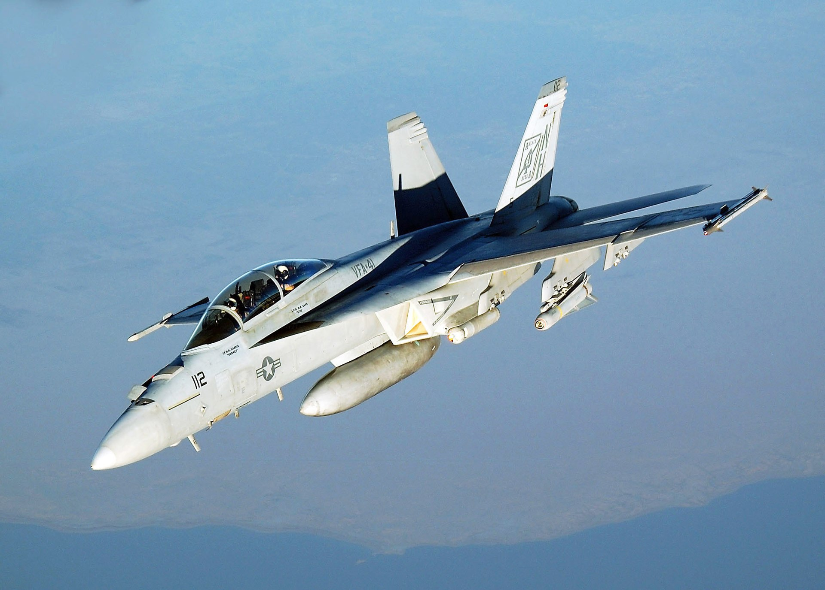
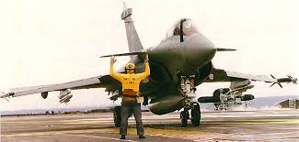
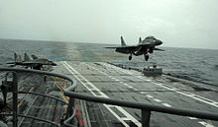
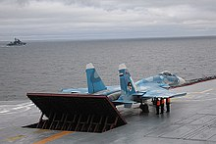
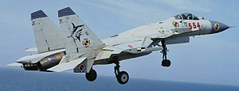
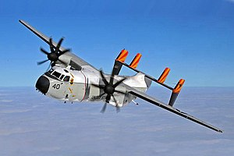
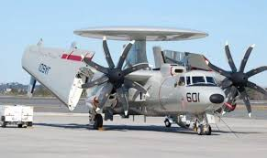
FIXED WING CARRIER BORNE AIRCRAFT 1
French Rafale
Indian/Russian MIG 29
US F18 HORNET
Russian SU 33
Chinese J 15
US C2 Greyhound
US Hawkeye
Notes:
Here are a selection of world wide current fixed wing Carrier Bourne aircraft. Note the US has 2 turboprop planes the Hawkeye for Airborne Early Warning and the Greyhound for general duties such as mail and personnel transfers.

Slide 13
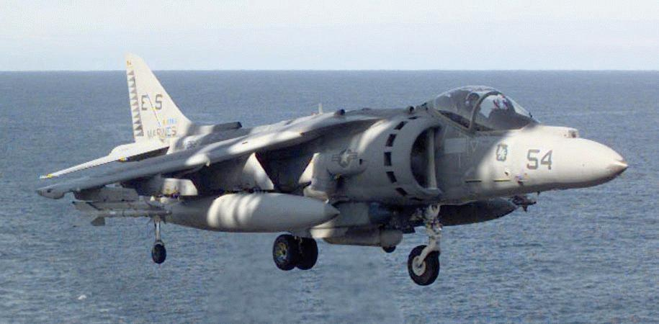
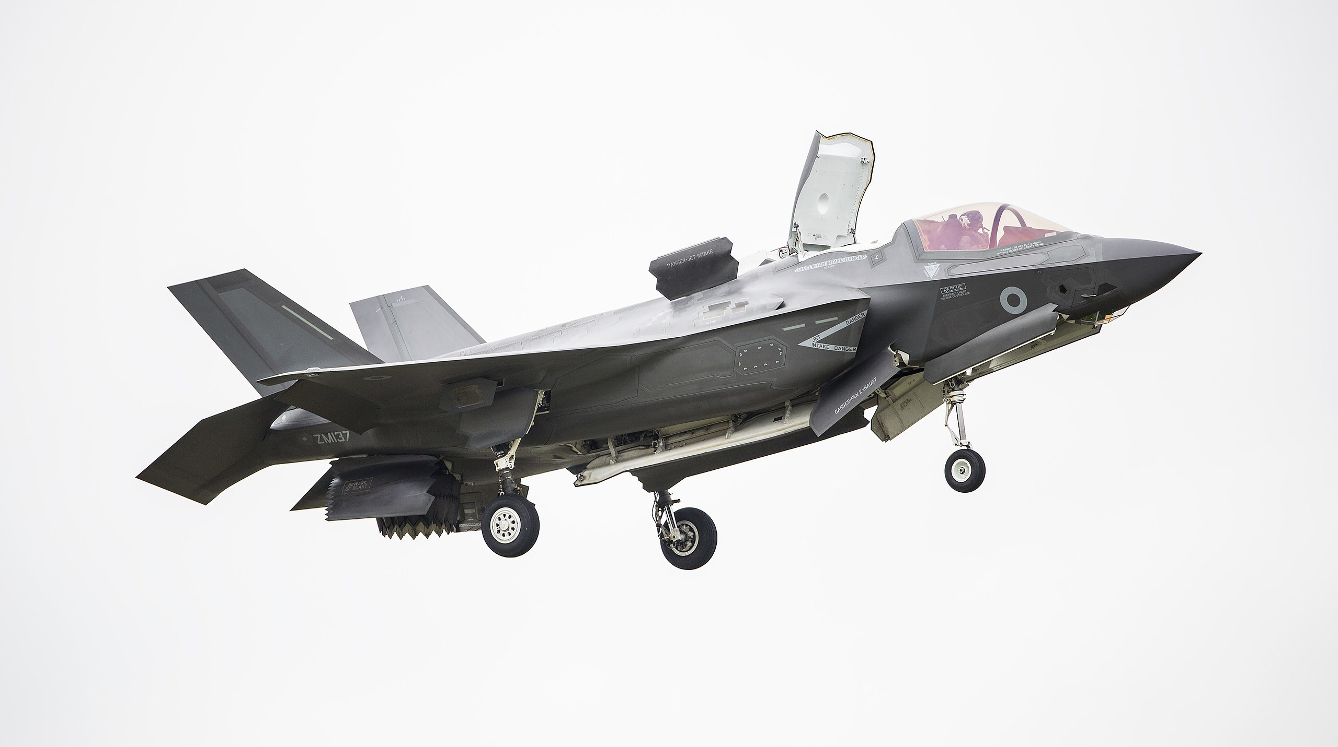
FIXED WING CARRIER BOURNE AIRCRAFT 2
AV8B Harrier
F35B/C – LIGHTNING II
Notes:
This is the carrier borne fighter aircraft of the future the F35. The B version shown here is the short take off vertical landing version to be used by the US Marine Corps (replacing the current Harrier AV8B) and the UK. The C version will be a catapult launched arrested recovery version to be used by the USN.

Slide 14
CURRENT FIXED WING AIRCRAFT CARRIER NATIONS
United States – 11(+2)
China -2
Italy -2
India -1
Russia -1
France -1
Spain - 1
Notes:
There are only 21 fixed wing aircraft carriers operational in the world at present – and I am including the US Navy's Was Class amphibious assault vessels here as they operate harriers.
It’s a small, select group of countries.
Note the UK is not included – it won’t have an in service operating fixed wing carrier until the mid 2020s

Slide 15
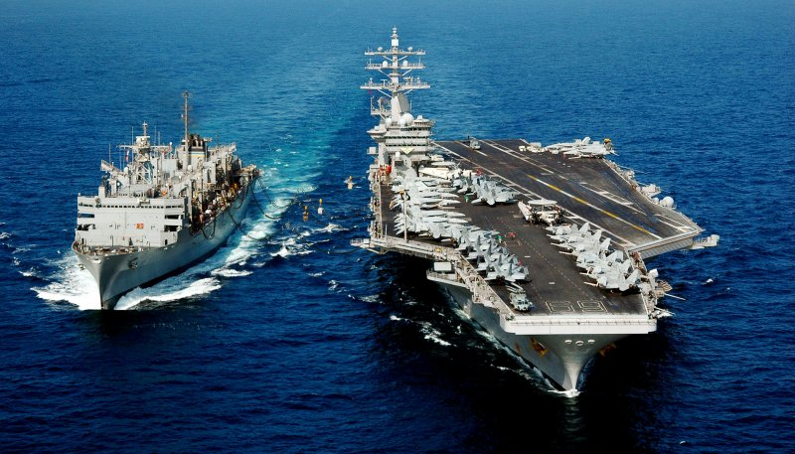
OPERATIONS AND STATISTICS
USS NIMITZ
Length 333m
Beam 77m
Draft 11.3m
Speed 35kts
Complement
3,200 ships company
2,480 airwing
90 Fixed wing aircraft and helicopters
Notes:
You can see the statistics here for a typical USN aircraft carrier – most others are smaller of course.
The never operate alone: Every few days they need to conduct underway replenishment with one of their supporting tankers to take on jet fuel and stores. They are invariably accompanied by protecting warships in a screen and often by a nuclear submarine in direct support. Although they have some close in weapon systems to take out any missiles or weapons that get through the screen, their primary armament is their air wing.
They can launch and recover aircraft simultaneously, both day and night. A few years ago I was privileged to spend a few days on the USS Enterprise on operations in the gulf. I watched night operations. The most impressive thing I had ever seen. There is a small platform called the Landing Signal Officers sponson adjacent to the flight deck. I was there when the jets came back. As they line up to land, a pilot of that type of aircraft directs the plane in on finals. He has an optical sight and tells the approaching plane to move up/down etc and when in range to call the ball – that is to say whether he can see correct lights on the optical guidance system to see that he is on the right glide path. As the plane comes in with its tail hook down, it tries to catch one of 4 arrestor wires as it touches down, it also puts on full power in case it misses and has to bolt or take off again (they never told me about that and I nearly jumped over the side when the first one landed). We had one bolter. Once caught the plane is immediately moved out of the way so the next one can land.

Slide 16
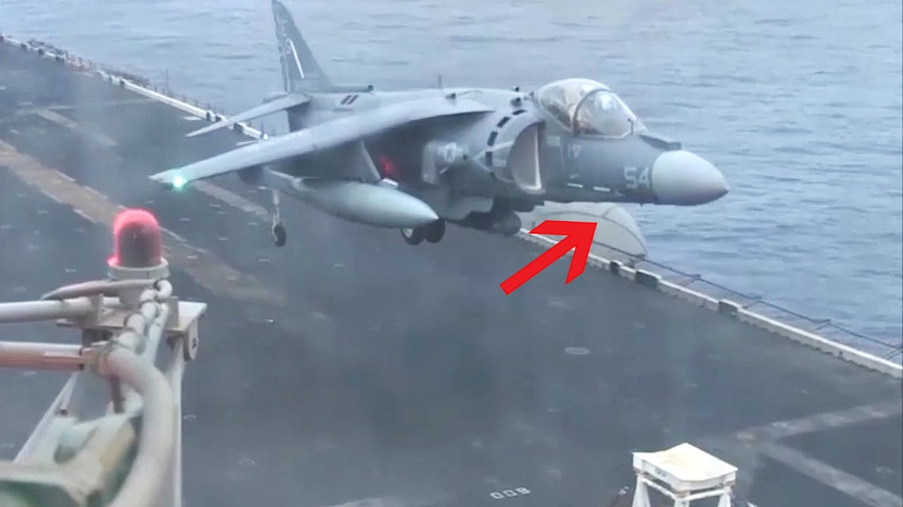
WHEN THINGS GO WRONG
MATTRESSES
NOSE WHEEL NOT DEPLOYED
Notes:
SEA HARRIER LANDING STORY

Slide 17
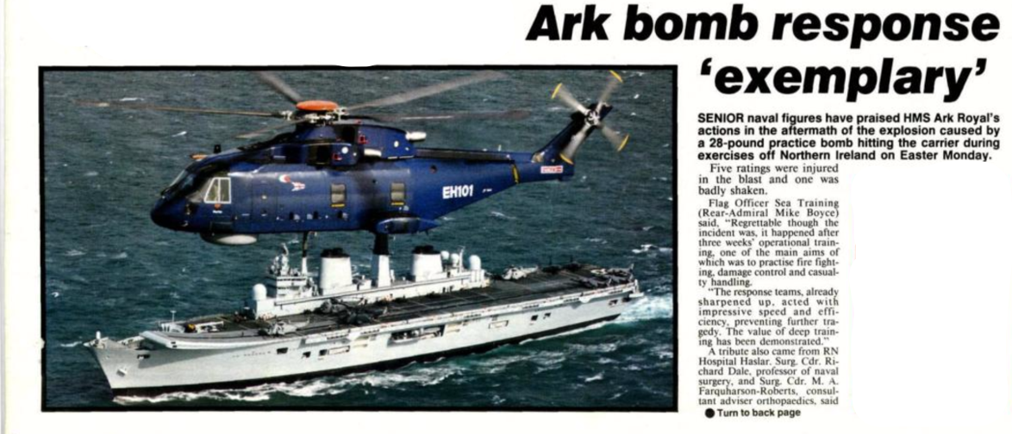
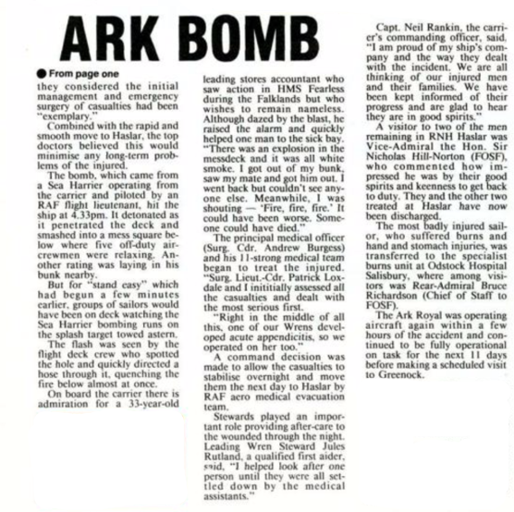
WHEN THINGS GO WRONG 2
Notes:
BOMB STORY
MONDAY April 13 1992
TOWING SPLASH TARGET
FORGOT THE AIM OFF
TOSS BOMB
FIVE INJURED
ONE LST FINGERS

Slide 18
CONCLUSION
https://vimeo.com/173082990

